Slide 1





ALFA - Point Cloud Compression for Streaming
ESRGv3
Francisco Dias
Advisor: Tiago Gomes PhD
Co-Advisor: Ricardo Roriz
Universidade do Minho
Notes:
!!!!!!!!!!!!!!!!!!!!!!!!!!!!!!!!!!!!!!VER titulo da tese !!!!!!!!!!!!!!!!!!!!!!!!!!!!!

Slide 2
Contextualization
LiDAR,Point Cloud, Compression…

Slide 3
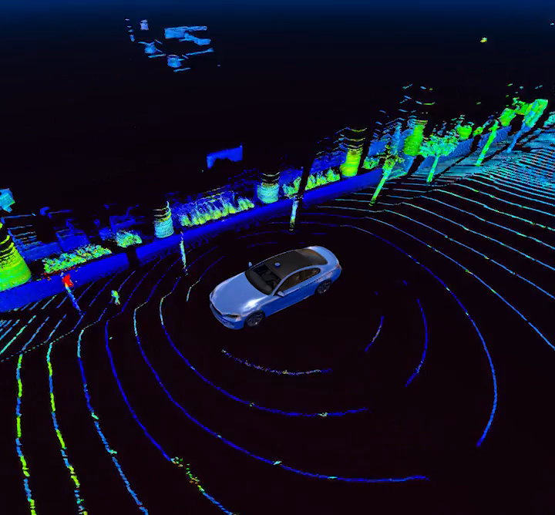
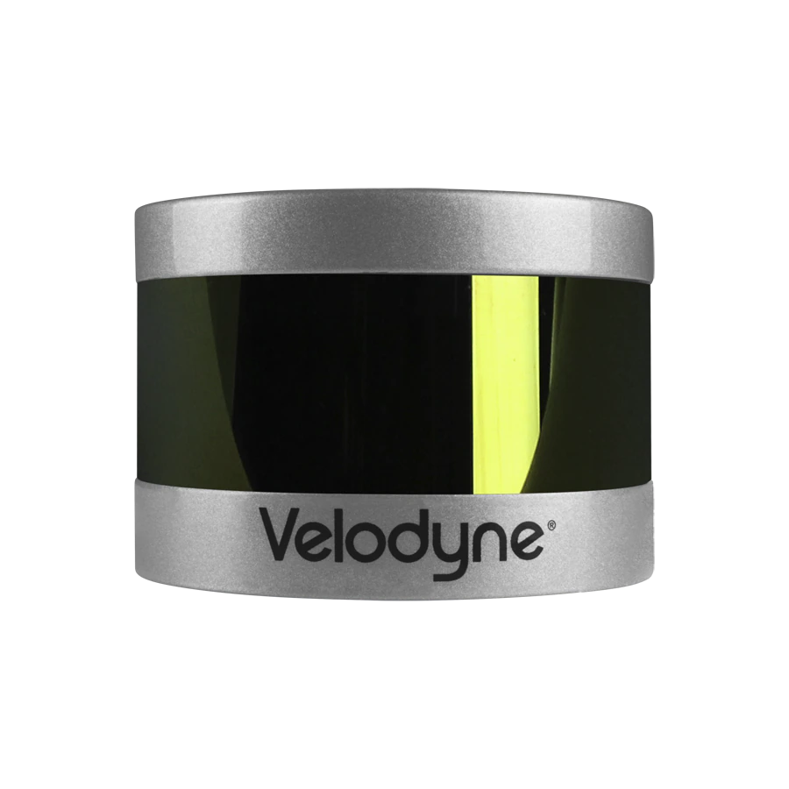


LiDAR
LiDAR, (Light Detection and Ranging), is used for measuring the exact distance of an object.
A LiDAR system calculates how long it takes for beams of light to hit an object or surface and reflect to the laser scanner. The distance is then calculated using the velocity of light.
Repeating this process millions of times per second creates a precise, real-time 3D map of the environment.
Applications:
Autonomous driving
VR/AR
Telecommunications
World Heritage
Bio-medical imagery
ESRGv3
3

Slide 4
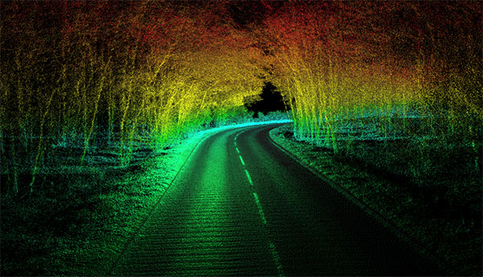
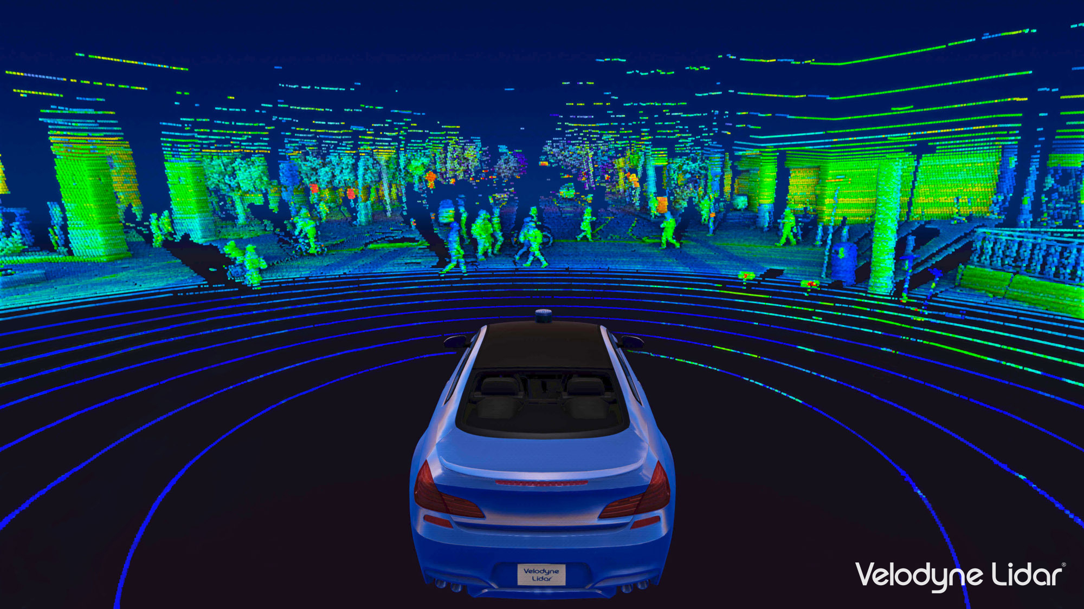
Point-Cloud Compression
Point-clouds always carry a huge amount of data
Processing real-time point-cloud data can achieve Gbit/s.
COMPRESSION
Efficient compression methods are mandatory for ensuring the transmission of such data.
Advantages:
Reduction of data transmission time
Compressed data is read/written faster than original data.
Efficient transmission
ESRGv3
4
Notes:
Escrever mais coisas, focar no real’time ??? Ou Streaming ???

Slide 5
ALFA
Framework for Automotive

Slide 6
ALFA – Advanced LiDAR Framework for Automotive
Generic and multi-sensor interface
Several pre-processing algorithms
Configurable output for High-level applications
Reconfigurable point-cloud representation architecture;
An open-source Framework for Automotive
ESRGv3
6

Slide 7
Goals

Slide 8
Goals
The main goal of this dissertation is to develop an FPGA based approach to point-cloud compression for streaming.
Software library to enable point-cloud compression in ALFA platform
Hardware extension to enable point-cloud compression in ALFA platform
ALFA integration
ESRGv3
8
Notes:
Streaming ??

Slide 9
Relevance

Slide 10
Relevance – Technical & Scientific
Autonomous driving is the new trend in the automotive industry
Greater Road Safety
Reduced Congestion
Environmental Gains
Real-time point-cloud compression is a key challenge in LiDAR technology:
LiDAR technology will be particularly influential in autonomous driving according to experts.
Developing efficient compression methods and technologies has become increasingly defiant and important.
ESRGv3
10
Notes:
Trocar as frases, redundante ??

Slide 11
Motivation

Slide 12

Motivation
Automotive Field
LiDAR Technology
Hardware Design
Linux
Embedded Systems
ESRGv3
12

Slide 13
THANK YOU!
ANY QUESTIONS?
| Francisco Dias a85023 | faodonline98@gmail.com |

Slide 14
TABLE OF
CONTENTS
01
Contextualization
02
ALFA
03
Technical-scientific Relevance
04
Motivation
05
Conclusion
Notes:
1. This is the agenda for today ...

Slide 15
PCC – Point Cloud Compression
“...”
Compression
ESRGv3
15

Slide 16
LiDAR – Point-Cloud
Set of individual 3D points.
Each point, in addition to having a 3D (x, y,z) position, i.e., spatial attribute, may also contain several other attributes such as color, reflectance, surface normal, etc.
There are no spatial connections or ordering relations specified among the individual points.
Applications:
Autonomous driving
VR/AR
Telecommunications
World Heritage
Bio-medical imagery
ESRGv3
16

Slide 17
Goals
1
Software library to enable point cloud compression in ALFA platform
2
Hardware extension to enable point cloud compression in ALFA platform
3
ALFA integration
ESRGv3
17
Notes:
Streaming ??

Slide 18

